Slide 1
SoSe Term 23 Responsible Artificial Intelligence Lecture-5: Experimental Philosophy
Prof. Dr. Holger Giese (holger.giese@hpi.uni-potsdam.de)
Christian Medeiros Adriano (christian.adriano@hpi.de) - “Chris”
Christian Zöllner (Christian.zoellner@hpi.de)
Matthias Barkowsky (Matthias.barkowsky@hpi.de)

Slide 2
The role of the philosopher’s intuition - I
“… A familiar form of analytic technique consists of proposing necessary and sufficient conditions for the truth of a schematized form of sentence containing a term under investigation.
Philosophers ask
what it is for A to know K, or
under what conditions it is true that C causes E, or
what makes it true that “A did C intentionally.”
Then they run through various previously proposed necessary and sufficient conditions, rejecting in turn any that are open to counterexample.
Sorell, T., 2917, Scientism (and Other Problems) in Experimental Philosophy

Slide 3
The role of the philosopher’s intuition - II
“a counterexample is a situation in which the proposed necessary and sufficient conditions obtain but the philosopher is disinclined to say, or is inclined to deny, that A knows that p or that e causes e’ and so on. In these cases, the inclination or disinclination is driven by the philosopher’s own (semantic) intuitions”

Slide 4
Sufficiency and Necessity

Slide 5
Sufficient and Necessary Conditions-1
If <antecedent> then <consequence>
A is sufficient for B = If A then B
A is necessary to B = If B then A, or If not-A then not-B (counter-positive case)
Example-1: If I have a driver's license, then I passed the driving test
Passing a driving test is a necessary condition for having a driver's license
Having a driver's license is a sufficient condition for having passed the driver's test (a bit awkward, but correct)

Slide 6
Sufficient and Necessary Conditions-2
Example-2: “A” being of a superclass is a necessary condition for “A” to be in a subclass of it.
Superclass == rectangle, Class == square
A == shape S being a square, B== shape S being a rectangle
If A (S is a square), then B (S is rectangle),
this implies that S being a square is a sufficient condition for S to be rectangle
If not B (S is not a rectangle), then not A (S is not a square),
this implies that S not being a rectangle is a necessary condition for it not to be a square

Slide 7
Sufficient and Necessary Conditions-3
Biconditional:
A is a necessary and sufficient for B
A if and only if B
(if A then B) and (if B then A)

Slide 8
Ladder of causality [Pearl 2019]
Layers | Use Cases
Layer-1 (Association /Prediction) | Given an input how to predict the outcome from the input? Inputs and outcomes are any measurable variable in the system. Uses: (1) allow to predict utility values from configuration values. (2) allow to predict environment outputs (observations) from inputs (also observations).
Layer-2 (Causation/ Intervention) | Given a certain intervention (sequence of actions), what is the probability of an effect of a certain magnitude? Uses: allow to estimate the effect of alternative actions so to evaluate how well a set of actions satisfy a goal.
Layer-3 (Counterfactual/ Reasoning) | Given a desired effect or probability of desired effect and contextual certain constraints (conditional values on certain covariates), which intervention (or sequence of actions) should I take OR how the various interventions rank Uses: allow to choose among different interventions when only the effect is known
Judea Pearl. 2019. The seven tools of causal inference, with reflections on machine learning. Commun. ACM 62, 3 (March 2019), 54–60. https://doi.org/10.1145/3241036

Slide 9
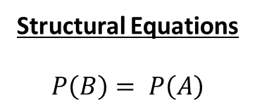
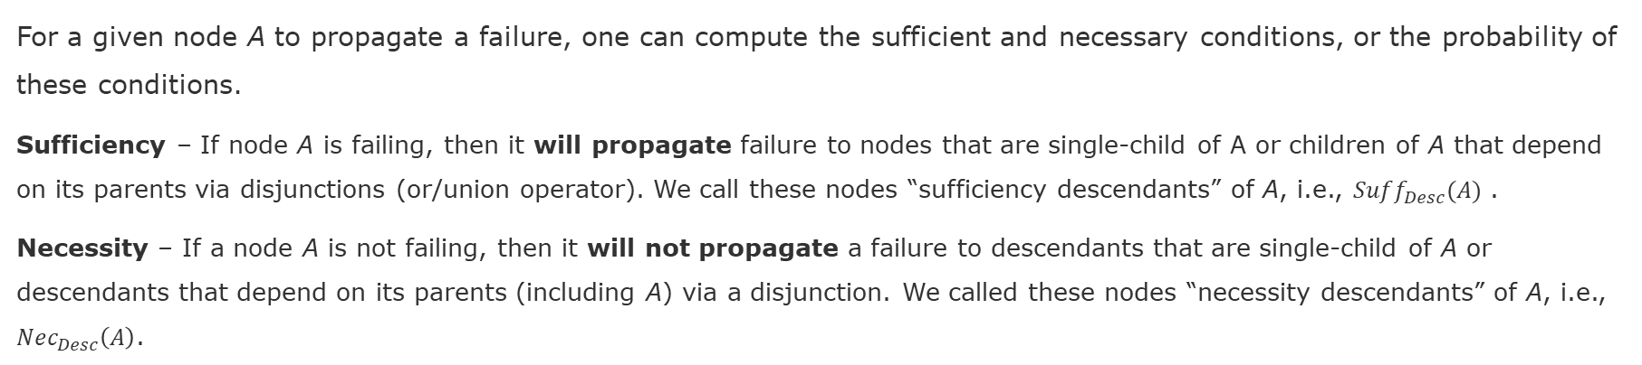
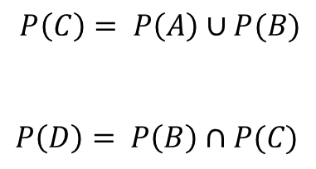
Sufficient and Necessary Conditions for Failure Propagation
For a given node A to propagate a failure, one can compute the sufficient and necessary conditions, or the probability of these conditions.
Sufficiency – If node A is failing, then it will propagate failure to nodes that are single-child of A or children of A that depend on its parents via disjunctions (or/union operator). We call these nodes “sufficiency descendants” of A, i.e., $Suff_{Desc}(A)$ .
Necessity – If a node A is not failing, then it will not propagate a failure to descendants that are single-child of A or descendants that depend on its parents (including A) via a disjunction. We called these nodes “necessity descendants” of A, i.e., $Nec_{Desc}\left(A\right)$.
System Graph
Structural Equations
$$P\left(B\right)= P\left(A\right)$$
Sufficient and Necessary Causes
A is a necessary and sufficient cause of B
B
D
A is a sufficient but not necessary cause of C
B is a sufficient but not necessary cause of C
B is a necessary but not sufficient cause of D
C is a necessary but not sufficient cause of D
A
$$P\left(C\right)= P\left(A\right)∪P(B)$$
$$P\left(D\right)= P\left(B\right)∩P(C)$$
C
Spatio-Temporal Dependency

Slide 10
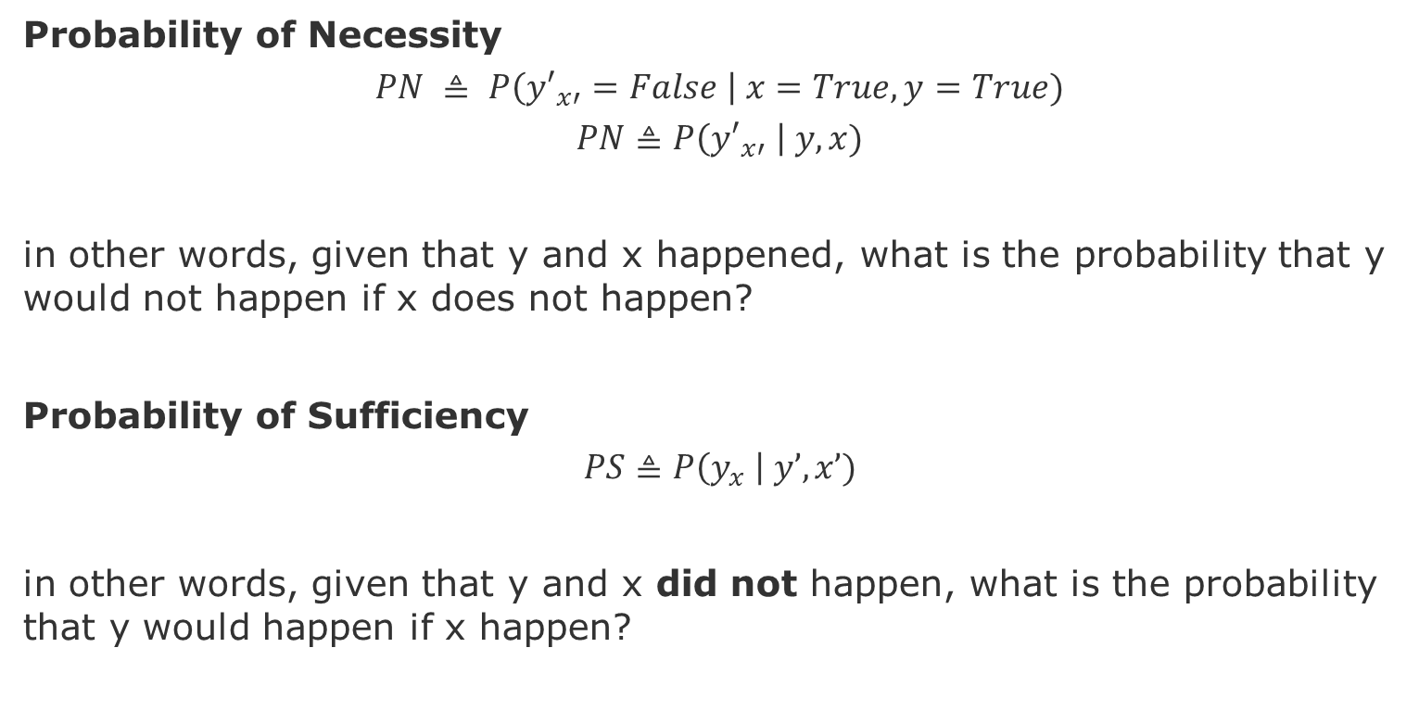
Sufficiency Necessity Probabilities with Counterfactuals -I [Pearl 2019b]
Probability of Necessity
$$PN ≜ P\left({y′}_{x′}=False \right| x=True,y=True)$$
$$PN≜P\left({y′}_{x′} \right| y,x)$$
in other words, given that y and x happened, what is the probability that y would not happen if x does not happen?
Probability of Sufficiency
$$PS≜P\left(y_{x} \right| y’,x’)$$
in other words, given that y and x did not happen, what is the probability that y would happen if x happen?
Pearl, Judea. "Probabilities of causation: three counterfactual interpretations and their identification." Probabilistic and Causal Inference: The Works of Judea Pearl. 2022. 317-372
Notes:
Pearl, Judea. "Probabilities of causation: three counterfactual interpretations and their identification." Probabilistic and Causal Inference: The Works of Judea Pearl. 2022. 317-372.
Gomes, Gilberto. "Necessary and Sufficient Conditions, Counterfactuals and Causal Explanations." Erkenntnis (2023): 1-24.

Slide 11
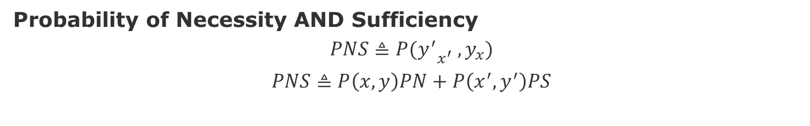
Sufficiency Necessity Probabilities with Counterfactuals -II [Pearl 2019b]
Probability of Necessity AND Sufficiency
$$PNS≜P{(y^{′}}_{x^{′}} , y_{x})$$
$$PNS≜P\left(x,y\right)PN+P\left(x^{′},y^{′}\right)PS$$
Pearl, Judea. "Probabilities of causation: three counterfactual interpretations and their identification." Probabilistic and Causal Inference: The Works of Judea Pearl. 2022. 317-372
Notes:
Pearl, Judea. "Probabilities of causation: three counterfactual interpretations and their identification." Probabilistic and Causal Inference: The Works of Judea Pearl. 2022. 317-372.
Gomes, Gilberto. "Necessary and Sufficient Conditions, Counterfactuals and Causal Explanations." Erkenntnis (2023): 1-24.

Slide 12
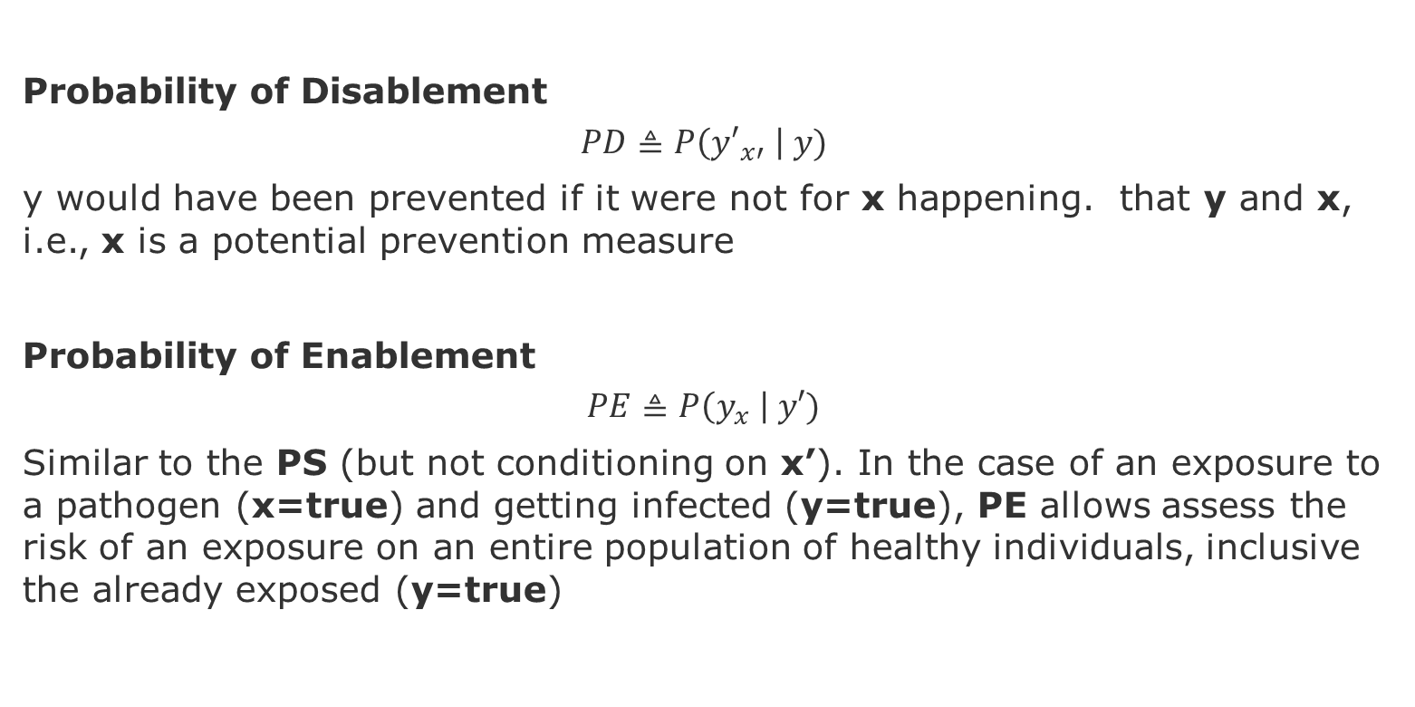
Sufficiency Necessity Probabilities with Counterfactuals -III [Pearl 2019b]
Probability of Disablement
$$PD≜P\left({y′}_{x′} \right| y)$$
y would have been prevented if it were not for x happening. that y and x, i.e., x is a potential prevention measure
Probability of Enablement
$$PE≜P\left(y_{x} \right| y′)$$
Similar to the PS (but not conditioning on x’). In the case of an exposure to a pathogen (x=true) and getting infected (y=true), PE allows assess the risk of an exposure on an entire population of healthy individuals, inclusive the already exposed (y=true)
Pearl, Judea. "Probabilities of causation: three counterfactual interpretations and their identification." Probabilistic and Causal Inference: The Works of Judea Pearl. 2022. 317-372
Notes:
Pearl, Judea. "Probabilities of causation: three counterfactual interpretations and their identification." Probabilistic and Causal Inference: The Works of Judea Pearl. 2022. 317-372.
Gomes, Gilberto. "Necessary and Sufficient Conditions, Counterfactuals and Causal Explanations." Erkenntnis (2023): 1-24.

Slide 13
Experimental Philosophy

Slide 14


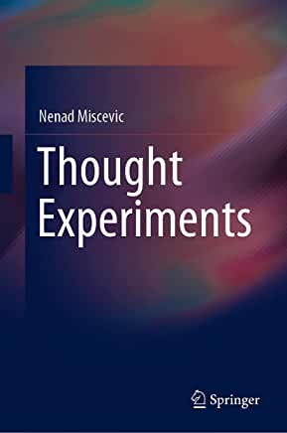
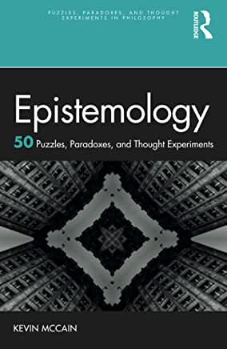
Sources (Books that we have been reading)

Slide 15
Strides of Science on Philosophical Questions
Study morality with methods 'suitable to the investigation of natural facts' (Jesse Prinz)
Results of fMRI scans refute deontologism (Joshua D. Greene, Peter Singer)
Experimental psychology refutes moral intuitionism (Walter Sinnott-Armstrong) and virtue ethics (Gilbert Harman, John Doris)
David Hume moral sentiment derives from oxytocin, 'the moral molecule' (Paul J. Zak, Patricia Churchland)
Primatologists, evolutionary biologists, psychologists, and neuroscientists advocate the replacement of armchair ethics with an empirical
'science of morality' (Sam Harris)
'the science of good and evil' (Michael Shermer),
'the science of our moral dilemmas' (Michael S. Gazzaniga)
Notes:
Initially, Robert Boyle, John Locke, members of the early Royal Society and like-minded authors in France and Italy applied this approach to empirical issues within physics and medicine and to metaphysical questions concerning, for instance, the nature of causation and the basic structure of the material world. Later experimentalists extended their rejection of 'first philosophy' and application of empirical methods to the fields of ethics and aesthetics. Scottish and German authors, like David Hume and J. G. H. Feder, advocated the 'application of experimental philosophy to moral subjects' (Hume) and relied on empirical claims to promote sentimentalist ethical theories.

Slide 16
The Manifesto [Knobe & Nichols 2007]
It used to be a commonplace that the discipline of philosophy was deeply concerned with questions about the human condition. Philosophers thought about human beings and how their minds worked. They took an interest in reason and passion, culture and innate ideas, the origins of people’s moral and religious beliefs. On this traditional conception, it wasn’t particularly important to keep philosophy clearly distinct from psychology, history, or political science. Philosophers were concerned, in a very general way, with questions about how everything fit together.
… experimental philosophy seeks a return to this traditional vision.. will involve us in the study of phenomena that are messy, contingent, and highly variable across times and places…
[However] Unlike the philosophers of centuries past, we think that a critical method for figuring out how human beings think is to go out and actually run systematic empirical studies. Hence, experimental philosophers proceed by conducting experimental investigations of the psychological processes underlying people’s intuitions about central philosophical issue,
Knobe & Nichols 2007, Experimental Philosophy

Slide 17
Sources (Online)
A Characteristic Difference- When Experimental Philosophy Meets Psychology - A Conversation between Joshua Knobe, Daniel Kahneman https://www.edge.org/conversation/joshua_knobe-daniel_kahneman-a-characteristic-difference
The New Science of Morality, Part 8
Joshua Knobe
https://www.edge.org/conversation/joshua_knobe-the-new-science-of-morality-part-8
Sytsma, J., & Livengood, J. (2019). On experimental philosophy and the history of philosophy: a reply to Sorell. British Journal for the History of Philosophy, 27(3), 635-647.
Tom Sorell (2018) Experimental philosophy and the history of philosophy, British Journal for the History of Philosophy, 26:5, 829-849

Slide 18
The Gettier Problems [Gettier 1963]
The Nature of knowledge: When do we know that we know something?
This is important because if we do not fully understand it, we could never fully understand ourselves either.
→We need a rigorous way to define what is it to know something.
→Traditional definition: knowledge of a proposition is a justified true belief in that proposition.
Propositional knowledge is usually stated in the following format “knowledge that p,” for instance, that the “knowledge that Swans have wings”. “p” is a truth or fact – a knowledge of how the world is, regardless of how we describe it by an arbitrary instance of “p”.
However, Gettier showed cases in which a belief can be both true and well supported by evidence but fails to be knowledge (for most epistemologists).
Notes:
American philosopher Edmund Gettier, who discovered them in 1963. - https://iep.utm.edu/gettier/
It is knowledge of a truth or fact — knowledge of how the world is in whatever respect is being described by a given occurrence of “p”.

Slide 19
Justified-True-Belief Analysis of Knowledge [iep 2021]
Belief: A person believes that p. This can be expressed in words (or not) and could be a more or less confident belief. The only thing necessary to make it a belief is that it exists and to be true and justified.
Truth: belief that p needs to be true. If the belief is incorrect (false), then, regardless of any quality of goodness or utility value, the believe cannot be considered knowledge.
Justified: belief that p needs to be well supported by good evidence or reasoning, or rational justification. Otherwise, the belief, even being true, it will be only a guess. In other words, although it could be correct, belief it is not knowledge without proper justification.
However, Gettier showed cases in which a belief can be both true and well supported by evidence but fails to be knowledge (for most epistemologists).
Notes:
American philosopher Edmund Gettier, who discovered them in 1963. - https://iep.utm.edu/gettier/
It is knowledge of a truth or fact — knowledge of how the world is in whatever respect is being described by a given occurrence of “p”.

Slide 20
The Gettier Case
Smith and Jones have applied for a particular job.
Smith has been told by the company president that Jones will win the job.
Smith knows from his observational evidence of there being ten coins in Jones’s pocket, which he.
Smith infers that whoever will get the job has ten coins in their pocket (call it belief b) Notice that Smith is not thereby guessing. The belief if true and reasonably justified.
However, belief “b” is true in a different way - it is Smith who will get the job, and Smith himself also has ten coins in his pocket.
These two facts combine to make his belief b true. Nevertheless, neither of those facts is something that, on its own, was known by Smith.
Given this reasoning, is Smith’s belief “b”, therefore not knowledge?
source: https://iep.utm.edu/gettier/
Notes:
Source: https://iep.utm.edu/gettier/
There is the company president’s testimony; there is Smith’s observation of the coins in Jones’s pocket; and there is Smith’s proceeding to infer belief b carefully and sensibly from that other evidence. Belief b is thereby at least fairly well justified — supported by evidence which is good in a reasonably normal way

Slide 21
Other Gettier Cases
The Lucky disjunction
The Sheep in the field
The Pyromaniac
The Fake Barn
Still, in none of those cases (or relevantly similar ones), say almost all epistemologists, is the belief in question knowledge.

Slide 22
Attempted Solutions to Gettier Cases
Infallibility - allowing fallible justification is all that it would take to convert a true belief into knowledge. Caveat – how much infallibility?
Eliminate Luck – does not allow too much luck, otherwise, we would again have reached for the Infallibility Proposal. Caveat - How much luck is too much?
Eliminate False Evidence – no belief is knowledge if the person’s justificatory support for it
includes something false. Caveats – (1) no false evidence can still be used to produce Gettier cases and (2) impossibility of complete absence of falsity in anyone’s belief

Slide 23
Attempted Solutions to Gettier Cases
Eliminate Defeat - what is not included in the person’s evidence: specifically, some notable truth or fact is absent from her evidence. what is needed in knowing that p is an absence from the inquirer’s context of any defeaters of her evidence for p.
A defeater is a particular fact or truth t defeats a body of justification j (as support for a belief that p) if adding t to j, thereby producing a new body of justification j*, would seriously weaken the justificatory support being provided for that belief that p — so much so that j* does not provide strong enough support to make even the true belief that p knowledge.
Insofar as one wishes to have beliefs which are knowledge, one should only have beliefs which are supported by evidence that is not overlooking any facts or truths which — if left overlooked — function as defeaters of whatever support is being provided by that evidence for those beliefs.
Caveat – how strong a defeater should be that it should not be overlooked?

Slide 24
Attempted Solutions to Gettier Cases
Eliminate Inappropriate Causality – belief should be caused — generated, brought about — in a normal way for it to be knowledge.
Caveats –applying only to empirical or a posteriori knowledge, knowledge of the observable world and difficulties with indirect causality and effects of absence of action (the gardener’s failure to water the plants causes their death).

Slide 25
In summary
When epistemologists claim to have a strong intuition that knowledge is missing from Gettier cases, they take themselves to be representative of people in general (specifically, in how they use the word “knowledge” and its cognates such as “know,” knower,” and the like).
That intuition is therefore taken to reflect how “we” — people in general — conceive of knowledge. It is thereby assumed to be an accurate indicator of pertinent details of the concept of knowledge — which is to say, “our” concept of knowledge.
So:
What evidence should epistemologists consult as they strive to learn the nature of knowledge?
Should they be perusing intuitions? If so, whose? Their own?
How should competing intuitions be assessed?
And how strongly should favored intuitions be relied upon anyway?
Are they to be decisive? Are they at least powerful?
Or are they no more than a starting-point for further debate — a provider, not an adjudicator, of relevant ideas?
Notes:
Jonathan Weinberg, Shaun Nichols, and Stephen Stich (2001) — conducting empirical research which (they argue) casts doubt upon the evidential force of the usual epistemological intuition about the cases.
The empirical evidence gathered so far suggests some intriguing disparities in this regard — including ones that might reflect varying ethnic ancestries or backgrounds. In particular, respondents of east Asian or Indian sub-continental descent were found to be more open than were European Americans (of “Western” descent) to classifying Gettier cases as situations in which knowledge is present. A similar disparity seemed to be correlated with respondents’ socio-economic status.
epistemologists’ intuitions are particularly trustworthy on this topic - Are they more likely to be accurate (than are other people’s intuitions) in what they say about knowledge — in assessing its presence in, or its absence from, specific situations?

Slide 26
Experimental Philosophy The four projects [carneades.org]
Psychology Project: how people reason matters
Goal: study the ways in which regular people think about philosophical questions and underlying theories.
Methods: Psychology methods
Verification Project: how philosophers disagree on each others’ intuitions matters.
Goal: discover which propositions or positions normal people find intuitive
Methods: Sociology methods
Sources Project: how intuitions arise matters
Goal: identify intuitions (i.e., w.r.t. moral questions) that arise through inappropriate means
Methods: use of fMRIs to distinguish between neurological processes
Variation Project: reliability of intuitions across context and culture matters
Goal: identify intuitions that vary across context (which might invalidate them)
Methods: Anthropology methods
Notes:
The Stanford Encyclopedia of Philosophy, The Internet Encyclopedia of Philosophy, The Cambridge Dictionary of Philosophy, The Oxford Dictionary of Philosophy and more!
Science can answer moral questions – Sam Harris – TED Talk - https://www.youtube.com/watch?v=Hj9oB4zpHww
https://www.youtube.com/watch?v=Xunjs-Mu-70

Slide 27
Assignment – May 16
Study the other four Gettier cases
The Lucky disjunction
The Sheep in the field
The Pyromaniac
The Fake Barn
Think of ways to inform our reasoning about a particular ethical dilemma, for instance, by obtaining answers to the following questions:
What are other popular ways of reasoning for your ethical dilemma?
How intuitive (easy to understand) people find certain reasonings?
How variations in phrasing affect people judgments?
When do people distinguish between the notion of knowing something versus just believing in something?

Slide 28
End

Slide 29
Overview of Design Space of Solutions

Slide 30
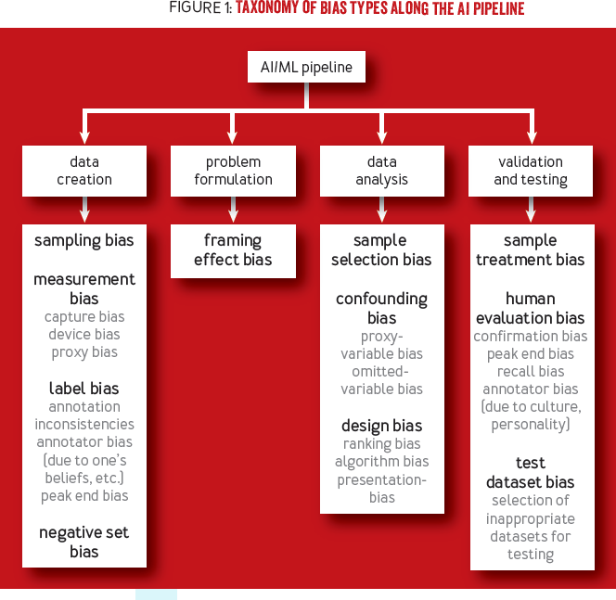
Taxonomy of Biases
There are many reasons for an engineer to have a wrong model of the world (figure-1)
These biases also impact users in very diverse ways.
I am more interested on bias sample selection bias and confounding bias (under the data analysis)
Before we delve into these bias, we need to answer the question, why many times simply getting more data does not solve the bias problem?
The Reason: the bias-variance trade-off
[Srinivasan & Chander 2021]
Notes:
[Srinivasan & Chander 2021]
]Biases in AI Systems
https://queue.acm.org/detail.cfm?id=3466134

Slide 31
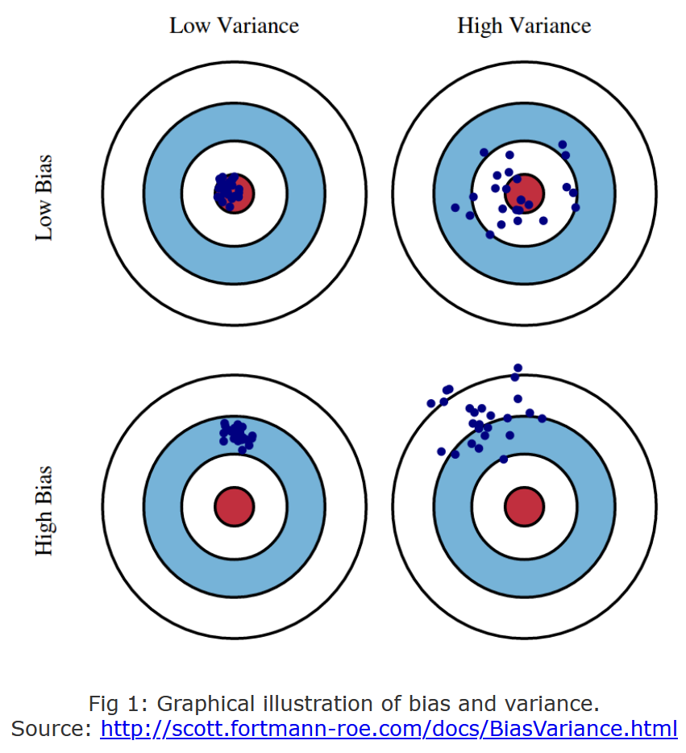
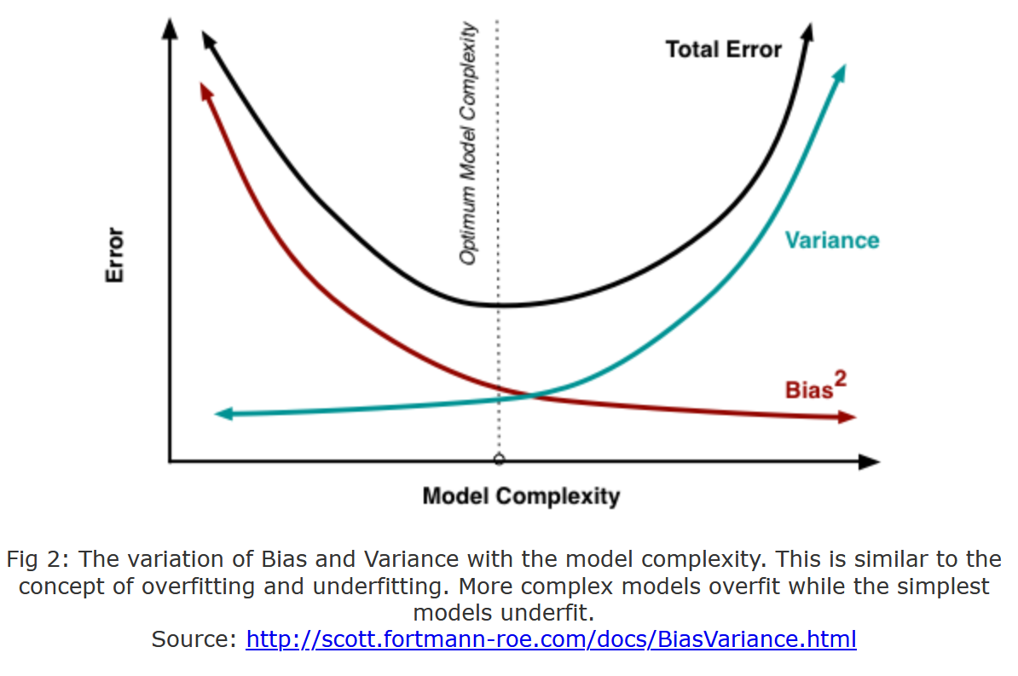
How do we currently think about robustness? -> Bias-Variance Trade-off

Slide 32
Implications to predictive models
Goal: Generalize data associations as predictive patterns
Assumptions: good data and observable patterns
Reality: sparse data and hidden states
Sparse data (Essential limitation, cannot eliminate with better prediction models)
Latent patterns (Accidental, can eliminate with better models)
Source – Misspecification
Not enough data or bad tunning of a model can make the concept drift more severe, as models might present strong bias (insensitive to crucial features) or high variance (too sensitive to noise).
Under-specification (leads to bias-underfitting)
Over-specification (leads to variance-overfitting)
Notes:
Model choice: wrong choice is accidental if not well-informed
Model generation: wrong if not well-informed
However, if after being informed with the best of our knowledge, choice and generation can still be affected by inherent difficulties posed by the essence of ml-based predictive models: Sparse data and Latent states. This means that better models can never eliminate the effects of sparsity and latency.
Nonetheless, it can still mitigate, reduce either their effects in terms of impact (magnitude) or their probability (over multiple training procedures).
Sparsity can be mitigated with models that allow to incorporate and update prior-knowledge, e.g., Bayesian methods, transfer learning methods.

Slide 33
Adversarial Changes in the Environment Sources of Sparsity and Unobservability
Changes in the Data Generation Process:
Covariate Shift (change in data distribution)
Domain Shift (change in the action-state space)
Concept Drift (change in the associations)
These changes are independent of the model, but the model might make the problem worse.
Goal: A robust model should have structures and conditions in place to mitigate the effect of these changes on the performance of the model.
Plausible Changes -> Sparsity + Observability -> Model performance

Slide 34
Mitigation of Ethical Failures / Dilemmas Data-Centric vs Systems-Centric
Data-Centric: Which data problems (data privacy violations, biases, etc.) are ethical dilemmas or failures in machine learning models? Mitigation might involve, pre-process data, obtain better data, augment data, or use more robust statistical methods (e.g., less prone to overfitting).
Systems-Centric: Which levels of autonomy contribute to ameliorate or degrade the ability of a system to handle ethical dilemmas?
Design Aspects - feedback loops, cross-cutting concerns (monitoring, exception handling, failure propagation), decision-making mechanisms (agents, controllers), and the corresponding actuators.
General Goal - How AI-Systems can self-adapt to cope with adversarial changes in the environment that impose ethical failures / dilemmas
Example: to redesign an avionics system to comply to a more appropriate set of ethical requirements one needs to go beyond better prediction models. One needs to understand which aspects of the system contribute to ethical failures and how these can be mitigated. Noting that mitigation actions might involve new ethical choices.

Slide 35
Adversarial Fragilities Online (Continual) Learning
Hidden confounders + Selection Bias
Simpson’s and Berkson’s paradoxes
Shortcut learning in Neural Nets
This goes beyond overfitting, as it cannot be solved with more or better data!
Underspecified Models
Unsafe state-action Spaces
Non-IID and OOD Data
Wrong predictions can spur unsafe actions that can lead to unsafe states.
Sensitivity analysis and testing on hold-out-sets are ad hoc approaches cannot guarantee safety.
“Program testing can be used to show the presence of bugs, but never to show their absence!” ― Edsger W. Dijkstra
Real-world is non-stationary
Predictions affects the data generation process
Modeling better recommender systems is not enough, because uncertainty grows wildly when extrapolating out-of-distribution
Notes:
“Program testing can be used to show the presence of bugs, but never to show their absence!” ― Edsger W. Dijkstra

Slide 36
Adversarial Fragilities - Solutions Online (Continual) Learning
Pre-trained models:
Optimal Bias-Trade-off for fine-tuning
Rashamon sets
Domain-Adaptation
Invariant Representations
Underspecified Models
Unsafe state-action spaces
Non-IID and OOD Data
Generative models of OOD
Sampling-based (importance sampling)
Feature-based (new task)
Intervention-based (control)
Safe learning in production:
Specify safety (domain-knowledge, Constrained MDP, Shielding)
Learn to be safe (sandbox/digital-twin)
Notes:
Operational envelope (engineering idea) for safe/robust learning (% of safety violation guarantee)
Business critical systems
Critical State Spaces
Envelope has to be evolved as well
How to know that the envelope is valid.
Lecture on Safety&Resilient Systems – structures that adjust (reviewing safety margins)
Accidents trigger reviews of safety margins
Human-on-the-loop (confirm the automated decision)
Recommendation system – how many are accepted vs rejected
Imitation learning vs Reward modeling
Crash example (how many people were affected), not possible, because measurements are also missing in a crash (income loss, satisfaction loss), e.g. Counterfactuals. These are phenomena that the runtime model can estimate indirectly (failed transactions)

Slide 37
Connections between Fairness and Robustness
Zhang, B. H., Lemoine, B., & Mitchell, M. (2018). Mitigating unwanted biases with adversarial learning. In Proceedings of the 2018 AAAI/ACM Conference on AI, Ethics, and Society (pp. 335-340).
Kilbertus, N., Rojas-Carulla, M., Parascandolo, G., Hardt, M., Janzing, D., & Schölkopf, B. (2017). Avoiding discrimination through causal reasoning. arXiv preprint arXiv:1706.02744.
Suggested questions
How do failures in satisfying fairness requirements lead to lack of robustness?
What type of robustness engineering methods can be used to reify fairness requirements?
How fairness can be achieved by means of Learning to be Safe, Fail-Safe Resilient, Recoverable mechanisms?
?

